Slide 1

Game of life
Group 8
马彦青 何雯芳 王赛 于海旭 黄玮婷
2020/05

Slide 2
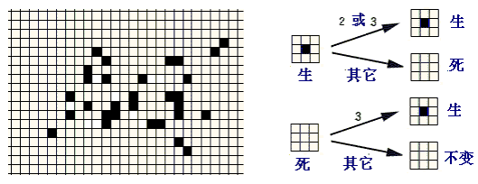
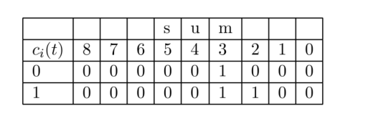
Rules
The rules for the Game of Life are quite simple as each cell has exactly two states (1 - alive, or 0 - dead) and the 8-cell Moore neighborhood is the one considered to determine the state of the central cell:
• A dead cell becomes alive at the next generation if exactly 3 of its 8 neighbors are alive;
• A live cell at the next generation remains alive if either 2 or 3 of its 8 neighbors is alive but otherwise it dies.

Slide 3
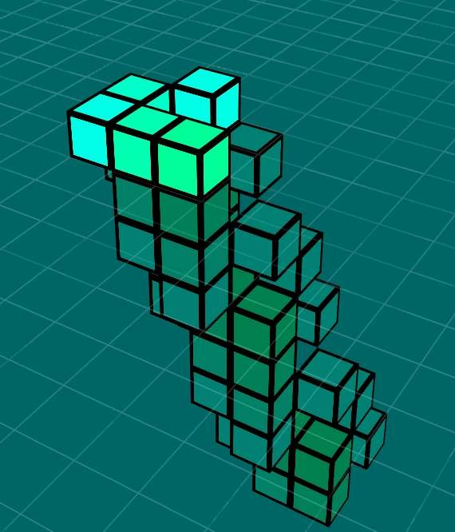
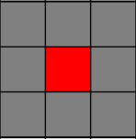
Structure
consists of the 8 or 9 cell array depending on whether or not the central cell is counted
with just two states 0 and 1 and a 9-cell Moore neighborhood，there are 2⁹= 512 possible neighborhood-states ranging from all white to all black with all the various 510 other combinations of white and black cells in between.
……

Slide 4
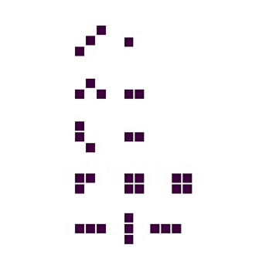
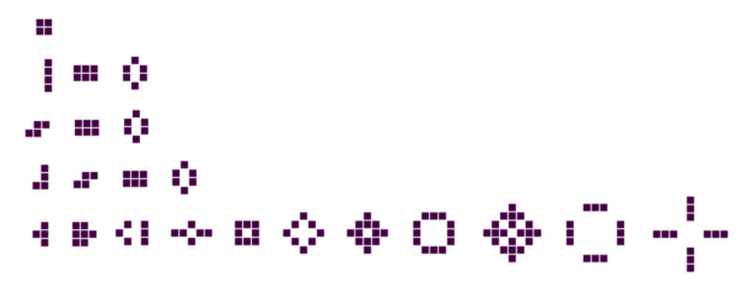
Lifeforms
Clearly any fewer than three cells will die in one generation.
Three cells
Four cells
Rapidly evolve to extinction(top three)
A block of static cells (4th row)
become an oscillating 2-cycle triplet (bottom row)
Evolve to stable forms(top four rows)
last two configurations of the last row alternate in a two-cycle

Slide 5

Patterns-invariant
Some common invariant forms : block, tub, beehive, ship, snake, pond, fishhook or eater, loaf

Slide 6
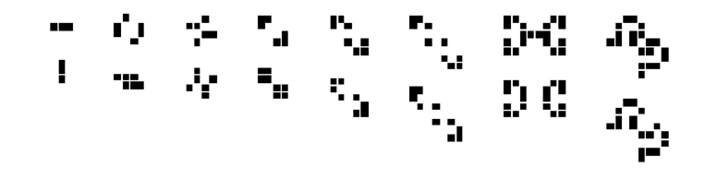
Patterns-Oscillators
Period-2 oscillators
Period-3 oscillator known as the CP-pulsar displaying its three different states

Slide 7
Pattern-Gliders and Spaceships
Gliders are another 5-cell configuration and they actually move one cell diagonally at the fourth time step .
By time step t + 4 the glider is reflected once again back to its original orientation, but one cell (diagonally) displaced. This 4-cycle is then endlessly repeated.
The maximum speed that information can propagate from one cell to another (either horizontally, vertically, or diagonally) is one cell per generation. In Life, this is known as the speed of light (c). Since the glider
moves exactly one diagonal cell after four generations, it is said to move at one-fourth the speed of light (c/4).
Conway has proved that the maximum speed of any configuration moving horizontally or vertically is c/2. Configurations that actually do move at this speed are what Conway called ‘spaceships’

Slide 8
Pattern-Glider gun
Would indefinitely generate gliders , thus disproving Conway’s conjecture that the number of live cells cannot grow without bound.
This arose out of work done by Robert April, Michael Beeler, R. William Gosper Jr., Richard Howell, Richard Schroeppel and Michael Speciner who were in the Artificial Intelligence Project at M.I.T. In November, 1970 they claimed the $50 prize offered by Conway.

Slide 9
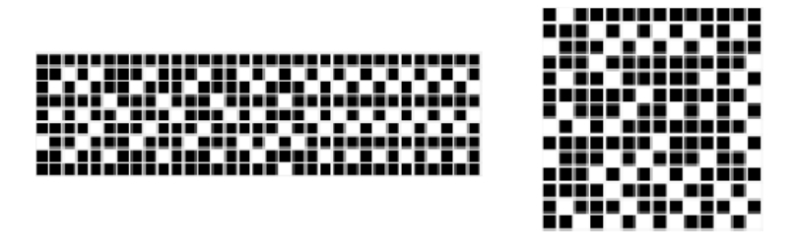
Garden of Eden
It is natural to ask if there are some patterns of cells that do not arise at all in the evolution of the system? A cellular automaton configuration that can have no prior configuration generating it (via the underlying local transition function) is called a Garden of Eden pattern
The Garden of Eden configurations for the Game of Life of Roger Banks (left) and Achim Flammenkamp, having 226 and 143 live cells respectively .

Slide 10
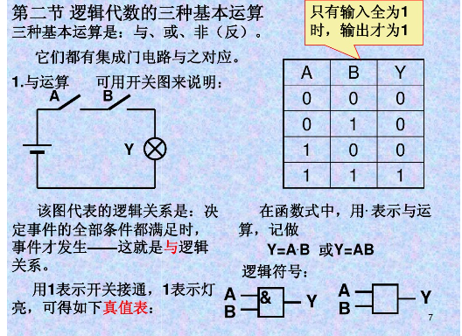
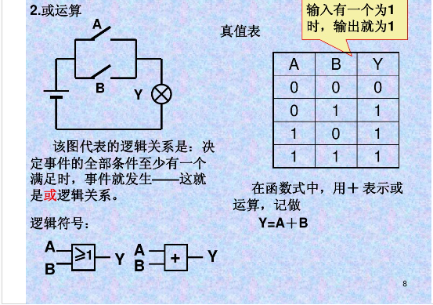
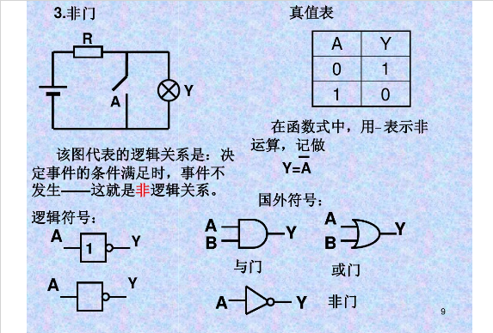
Logic gate- constructed within game of life
Logic gate：

Slide 11
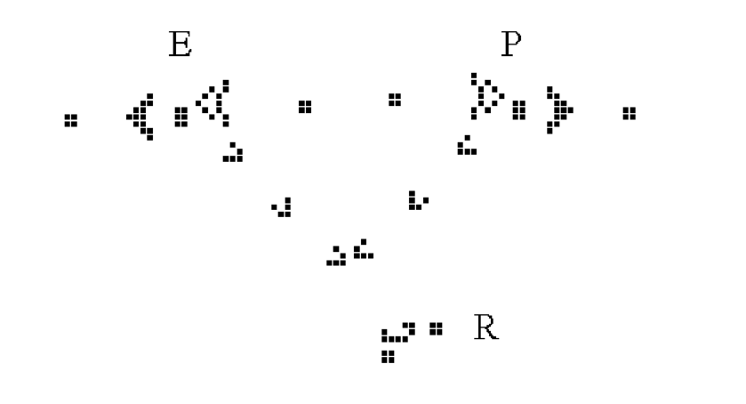
Logic gate- constructed within game of life
The NOT gate
P is either a 0 or 1 and a data source gun that emits a glider whenever P is 1 and nothing whenever P is 0. An emitter glider gun at E is positioned and is synchronized to fire gliders simultaneously. Whenever two gliders collide they will annihilate one another.
If P is 0 the result at the receptor R is 1 and if P is 1 the receptor receives no input, or 0 since the colliding gliders annihilate one another.

Slide 12
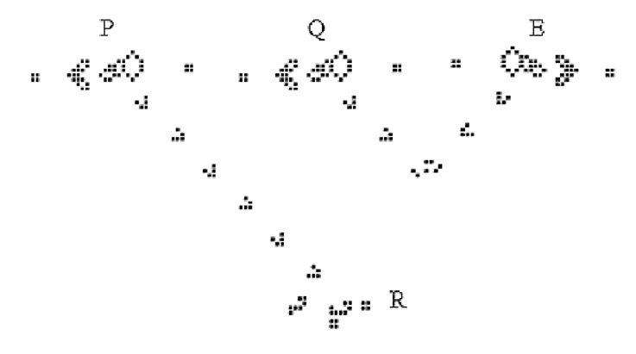
Logic gate- constructed within game of life
The AND gate
According to the Truth Table the conjunction P ∧ Q is to be the value 1 only when P is 1 and Q is 1. In all other cases, P ∧ Q is to be 0. Taking P and Q both to have truth value 1 as in the figure, results in a glider emanating from the glider gun Q being annihilated by the glider emanating from the emitter E, whereas the glider from P passes unhindered to produce a 1 at the receptor R.
Only when both P and Q are on does the receptor R receive any data. If only P or Q is on , then the gliders from E annihilate them and the receptor R receives nothing.

Slide 13
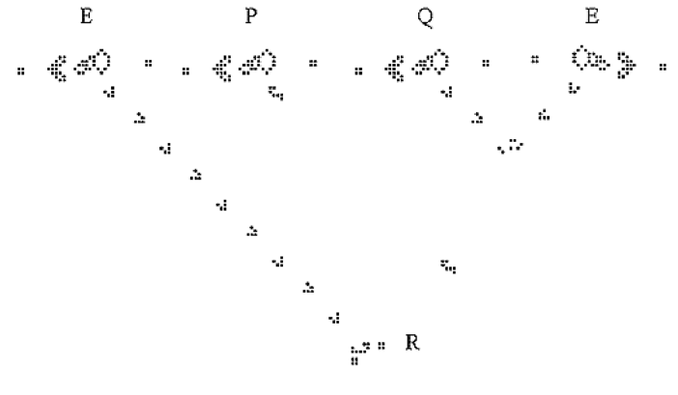
Logic gate- constructed within game of life
The OR gate
Two emitter glider guns, both designated E. P ∨ Q has truth value 1 if P or Q is 1 (or both) and is 0 in all other cases.
If both P and Q are off then the gliders from each emitter E annihilate each other and there is no signal at the receptor R. In the other cases when either P or Q are on or both are
on, a signal is received by the receptor R from the emitter on the left.

Slide 14
Planning
Project Two: Game of Life and Its application
Project Plan
5/1-5/8: The principle of game of life.
Learn the basic model.
Discuss core concepts: states, pattern and structure.
Report project progress.
5/8-5/15: The applications of game of life.
Genetic Algorithms or McCulloch-Pits Neural Model
5/15-5/22: Programming and thesis writing.
5/22-5/25: Project show and presentations.
Working Assignment
Model: 马彦青
Coding: 王赛
PPT：黄玮婷
Thesis: 何雯芳、于海旭

Slide 15
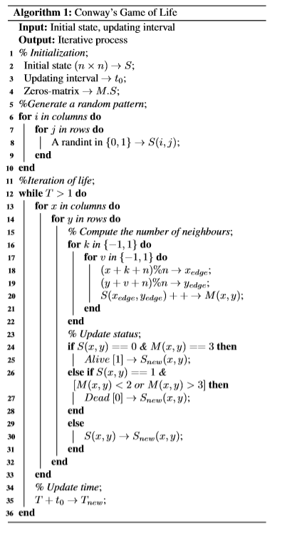
Coding of game of life

Slide 16
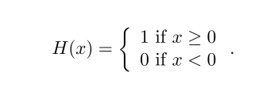
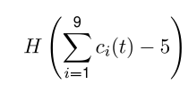
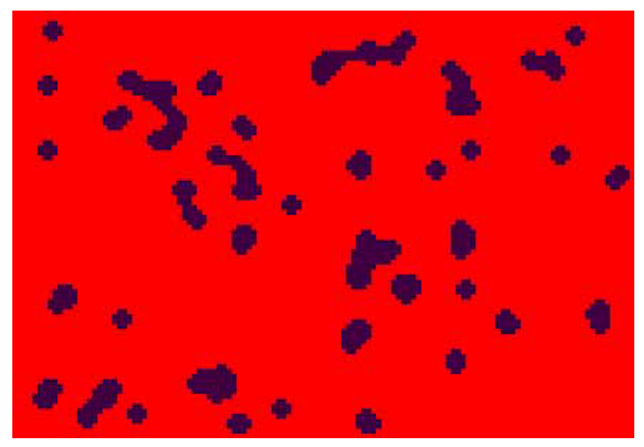
The cellular automaton Vote
There is another more scientific way to depict the Vote rule by using the so-called Heaviside step function H, also referred to as a threshold function.This is defined as follows:
according to the Vote rule, the value of the central cell at the next time step is given by:
whereby if five or more of the cells have state value ‘1’, then the function H returns the value ‘1’, otherwise it is ‘0’. The value of 5 is just a threshold value that turns ‘on’ the central cell at the next time step once the threshold is reached.

Slide 17
应用
Predicting the evolution of Conway's game of life with neural network

Slide 18
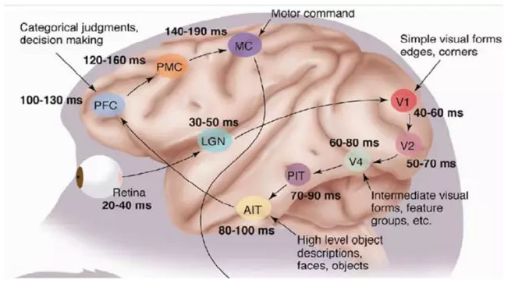
神经网络
1981 年的诺贝尔医学奖，颁发给了 David Hubel（出生于加拿大的美国神经生物学家） 和Torsten Wiesel，以及 Roger Sperry

Slide 19
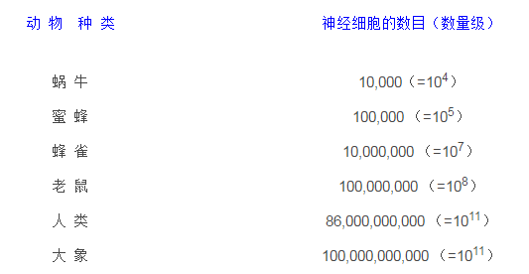
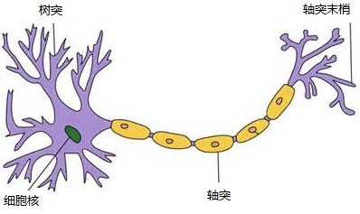
神经网络
每个神经细胞通过它的树突和大约10,000个其他的神经细胞相连。这就使得你的头脑中所有神经细胞之间连接总计可能有l00,000,000,000,000个，即100万亿种可能

Slide 20
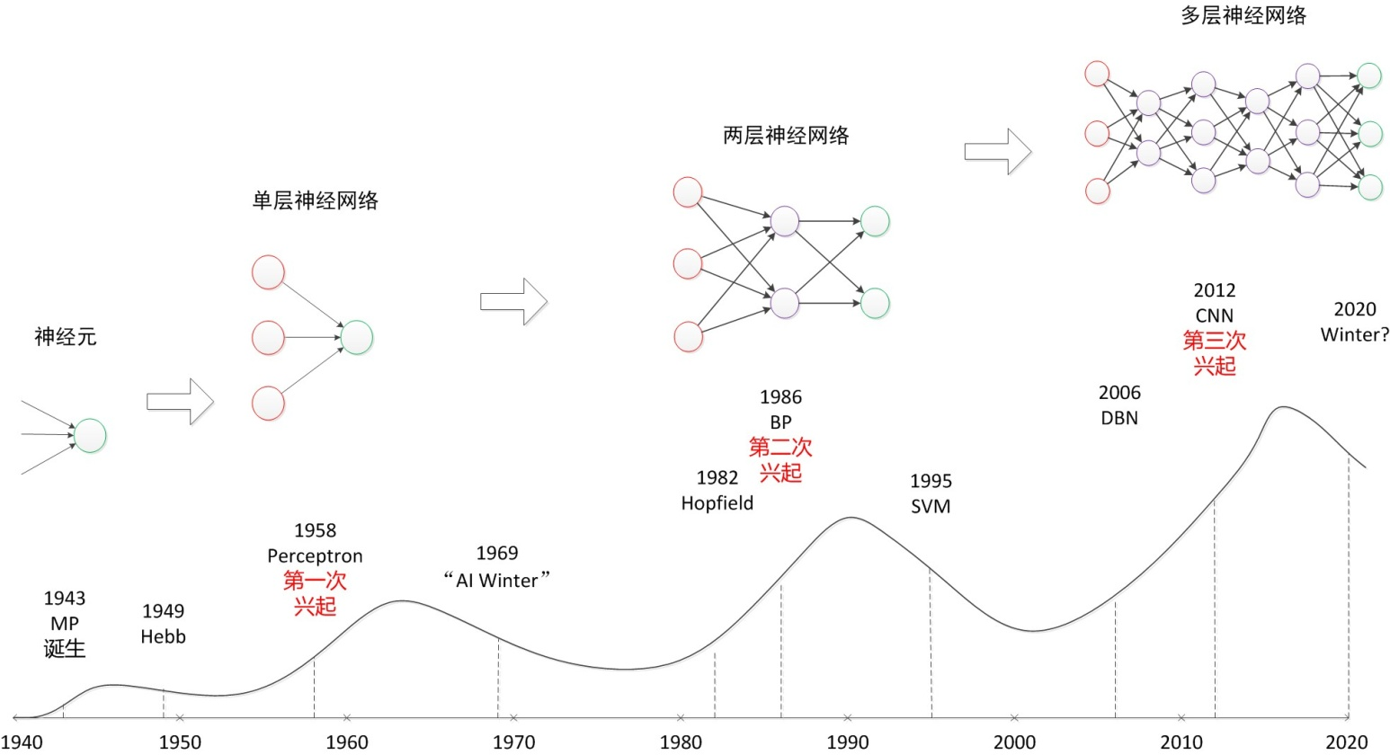
神经网络的发展

Slide 21
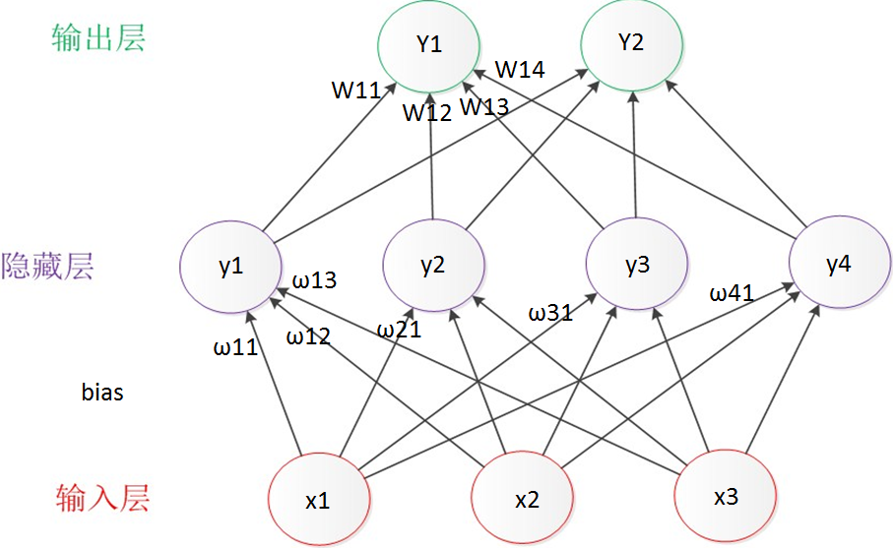
神经网络

Slide 22
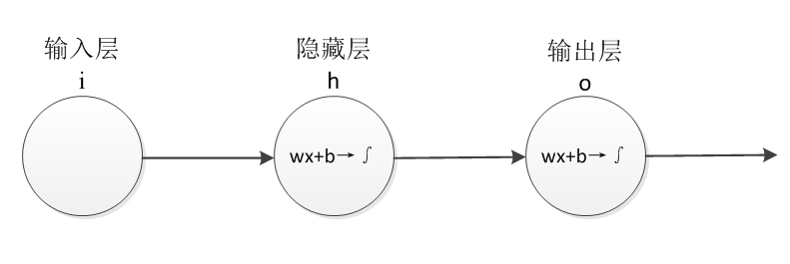
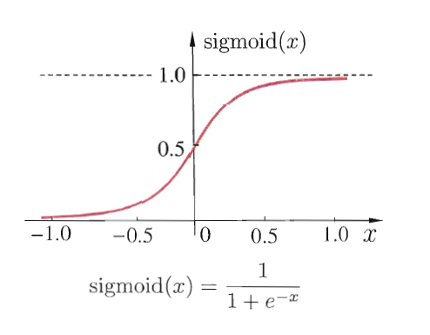
神经网络—激活函数
使用非线性激活函数能够从输入输出之间生成非线性映射

Slide 23


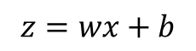
神经网络—误差公式
$$z=wx+b$$
每个x对应的y产生一个误差e： $e_{i}=y_{i}−\left(wx_{i}+b\right)$
$$Loss=\frac{1}{n}\sum_{i=1}^{n}{(y_{i}−(wx_{i}+b))^{2}}$$
误差公式：

Slide 24
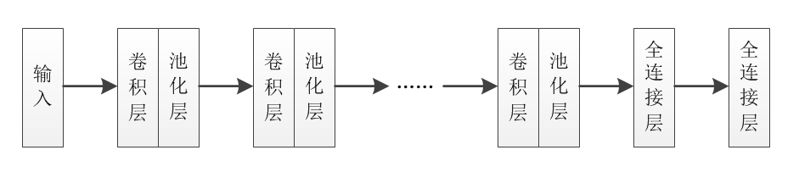
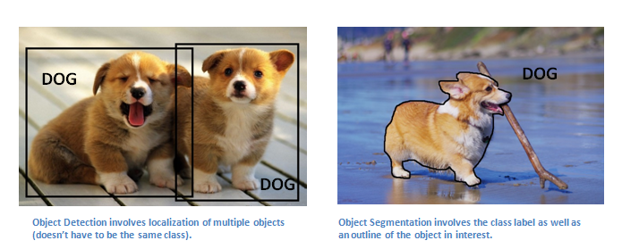
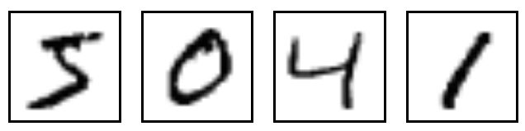
卷积神经网络
网络结构：卷积层、池化层、全连接层
图像分类
光学字符识别
人脸识别
视频分析
自然语言处理…

Slide 25
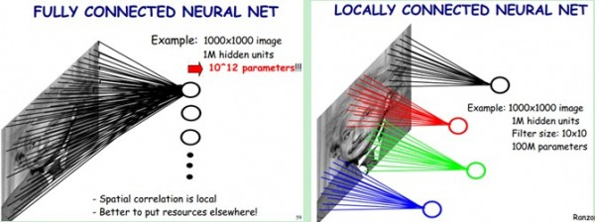
卷积神经网络
3D层结构：CNN每一层是一个三维结构，可看做数据立方体。
局部连接：层与层之间的神经元不进行全连接，前一层神经元仅通过卷积核与下一层神经元局部连接
共享权重：通过卷积运算大幅降低训练参数量

Slide 26
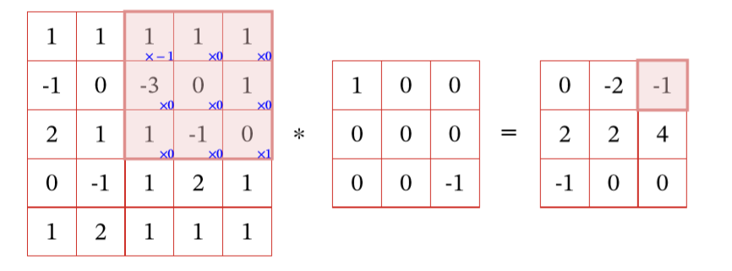

卷积神经网络
卷积层
Stride（步长）=1
Padding（零填充）=0

Slide 27
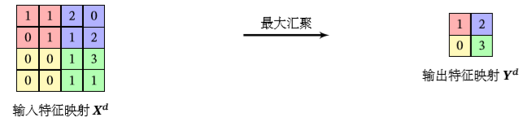
卷积神经网络
池化层——常用的是MaxPooling
对于一个区域，选择这个区域内所有神经元的最大活性值作为这个区域的表示.

Slide 28
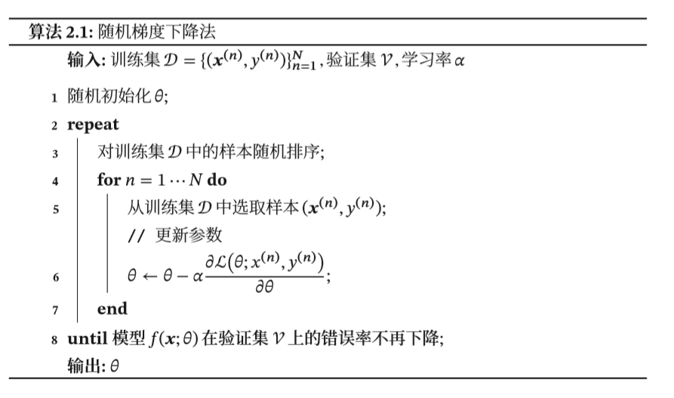
优化算法
最简单、常用的优化算法就是梯度下降法
为了减少每次迭代的计算复杂度，我们也可以在每次迭代时只采集一个样本，计算这个样本损失函数的梯度并更新参数，即随机梯度下降法

Slide 29
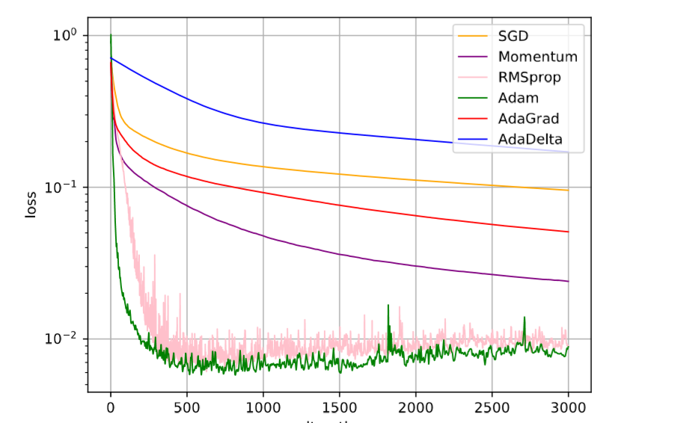
优化方法比较

Slide 30
卷积神经网络
训练方法
Back Propagation：信息的正向传递与误差的反向传播。
正向传播:输入信息从输入经逐层计算传向输出层，每一层神经元的状态只影响下一层神经元的状态。
误差的反向传播：如果在输出层没有得到期望的输出，则计算输出层的误差变化值，然后转向反向传播，通过网络将误差信号沿原来的连接通路反传回来修改各层神经元的权值直至达到期望目标。

Slide 31
应用-学习game of life的规则
STEP1
随机生成训练数据集：20*20个元胞 500个初始状态（100个随机“生”），进化10次
PYTHON+CNN
学习规则
STEP2
通过CNN进行训练：torch库；损失函数：MSE(均方误差)；激励函数：RULE；优化器：Adam；
STEP3
验证训练结果：随机或指定生成初始元胞图形，对比训练模型预测和真实规则之间的差异

Slide 32
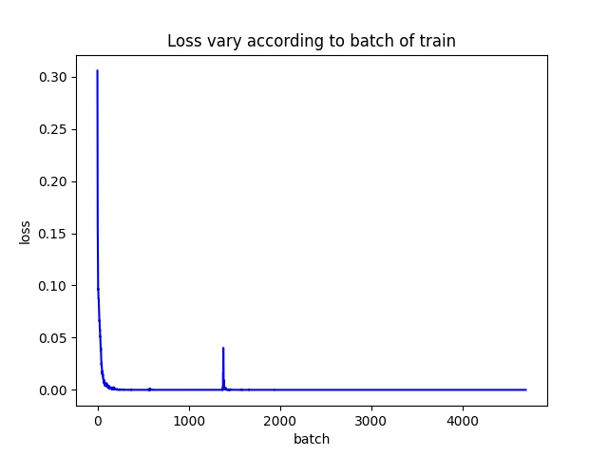
应用-学习game of life的规则

Slide 33
应用-学习game of life的规则

Slide 34
应用-学习game of life的规则

Slide 35
Thanks.

